Slide 1

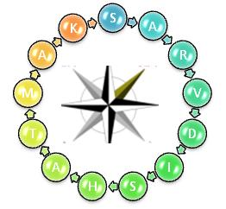

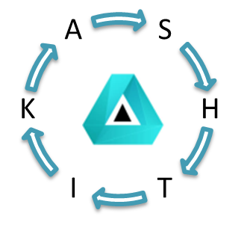

Quality Circle Project
Onkar Engine & Generator P Ltd
FY 2021-22

Slide 2
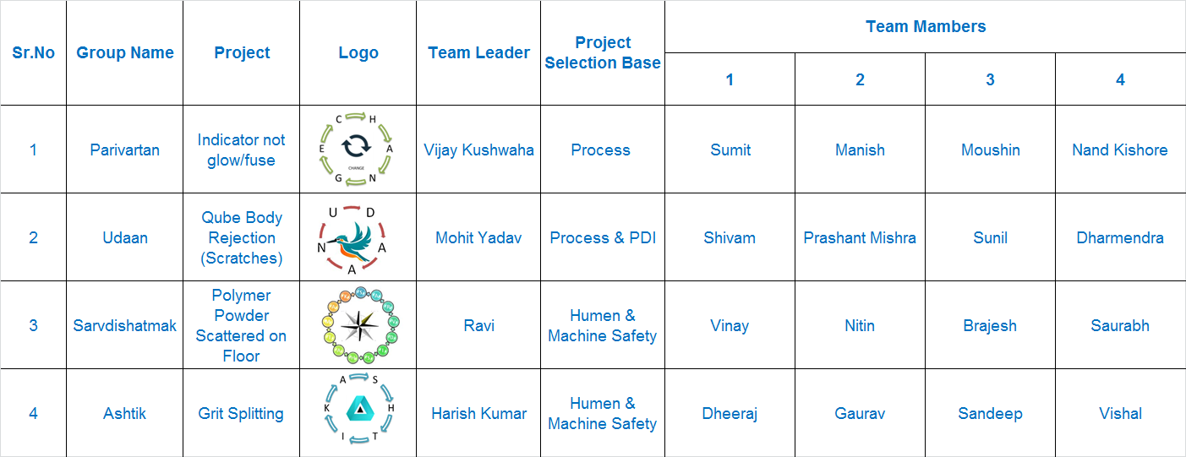
Quality Circle Team & Project Details (FY2021-22)

Slide 3
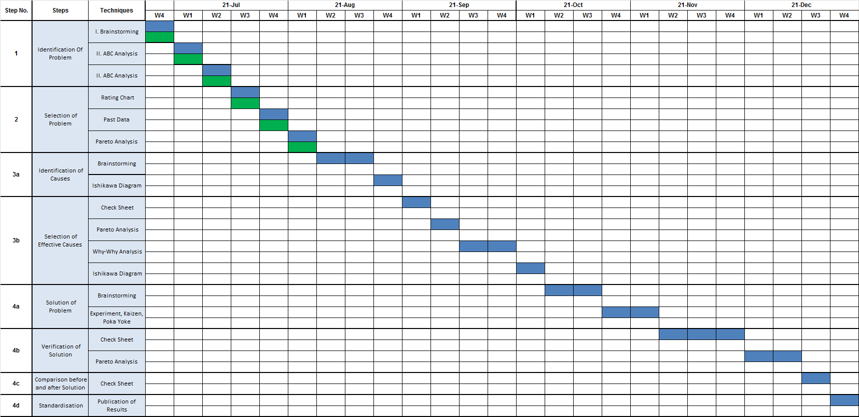
Project completion Road Map (Parivartan)

Slide 4
Project completion Road Map (Udan)

Slide 5
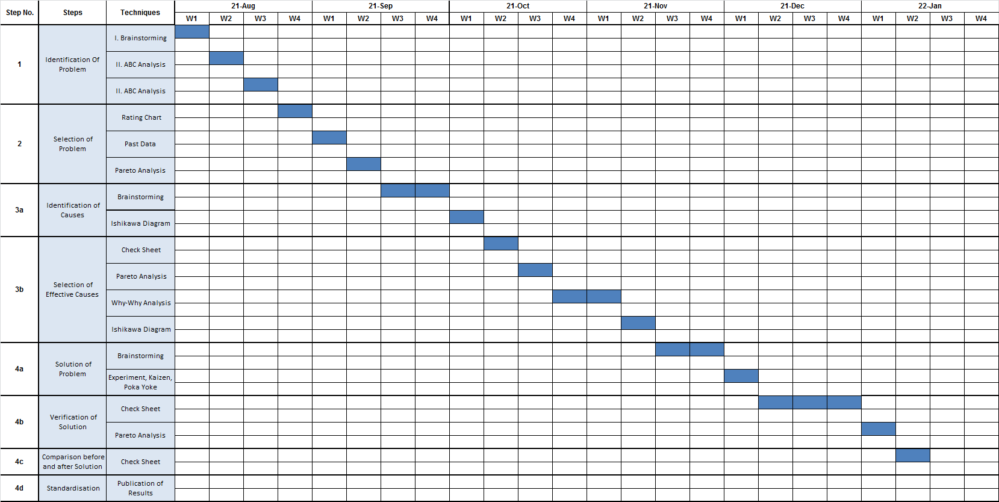
Project completion Road Map (Sarvdishatmak & Ashtik)

Slide 6
THANK YOU SIR

